Slide 2
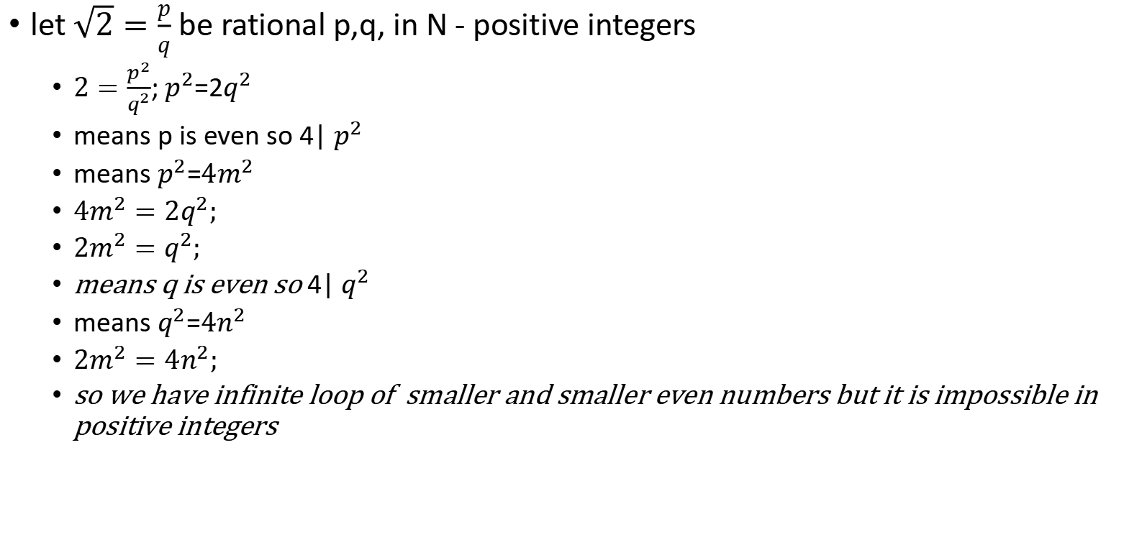
Prove that $\sqrt{2}$ is irrational
let $\sqrt{2}=\frac{p}{q}$ be rational p,q, in N - positive integers
$2=\frac{p^{2}}{q^{2}}$; $p^{2}$=2$q^{2}$
means p is even so 4| $p^{2}$
means $p^{2}$=${4m}^{2}$
${4m}^{2}=2q^{2};$
$2m^{2}=q^{2};$
means q is even so 4| $q^{2}$
means $q^{2}$=${4n}^{2}$
$2m^{2}={4n}^{2};$
so we have infinite loop of smaller and smaller even numbers but it is impossible in positive integers

Slide 3
Factorial equasion:
n²+19n-n!=0
n(n+19)= n!
n-1+20 = (n-1)!
t!-t=20 has only 1 solution
t 2 3 4 5
t! 2 6 24 120
answer = t = 4, n = 5
check : 5²+19*5-5!=25+95-120 = 0

Slide 4

Find all natural x,a,b so that:
$x^{a}+x^{b}=x^{a+b}=x^{a}x^{b}$
$m+n=mn (divide /mn$)
$\frac{1}{m}+\frac{1}{n}=1$
if m,n are natural digits and $m≥3 \frac{1}{m}≤\frac{1}{3}$ so
$\frac{1}{n}=1−\frac{1}{m}≥\frac{2}{3}$ - it can not be
so if m = 2 , n = 2,
if m = 1, $\frac{1}{n}=0$ , can not be so
answer is m = 2, n = 2 , means
$x^{a}=2 ,x^{b}=2 ,$
a=b=1, x = 2

Slide 5

find all m,n, so that :
$mn=m^{n}$
$m^{n−1}=n$
exponent is > linear with big digits, so:
if m = 1, n = 1 : $1^{0}=1$
if m = 1, n=2: $1^{1}≠2$
if m = 2 , n = 1:${ 2}^{0}=1$
if m=2, n=2 : ${ 2}^{1}=2$
if m $≥$ 3 , n = 1:${ m}^{0}=1$
if m $≥ 3$, n $≥$ 2 : $m^{n−1}>n$

Slide 6
7 is the only Prime followed by a Cube.
https://www.youtube.com/watch?v=A00ibdM5icg
p+1 = n³
if something with prime -> try to factor it:
p = n³-1 = (n-1)(n2+n+1)
if p is prime either n-1 = 1 or n2+n+1=1
n=2 (or n=0 or n = -1 , does not match)
answer: n = 2
followed by any grade:
p + 1 = n^{k}
p = n^{k} - 1 = (n-1)(n^{k-1} + n^{k-2} + ... + n + 1)
n-1 = 1 or n^{k-1} + n^{k-2} + ... + n + 1 = 1 , the second is not possible for n € N, so
p+1 = 2^{k}
if k is composite, k = ab, and
n^{ab}-1 = (nª-1)(...), where both factors are greater than 1, so k must be prime.
check:
2¹¹ -1 = 2048-1 = = 23 × 89
so, for some k € P we have p= 2^{k}-1 is prime
this is definition for meisen primes

Slide 7
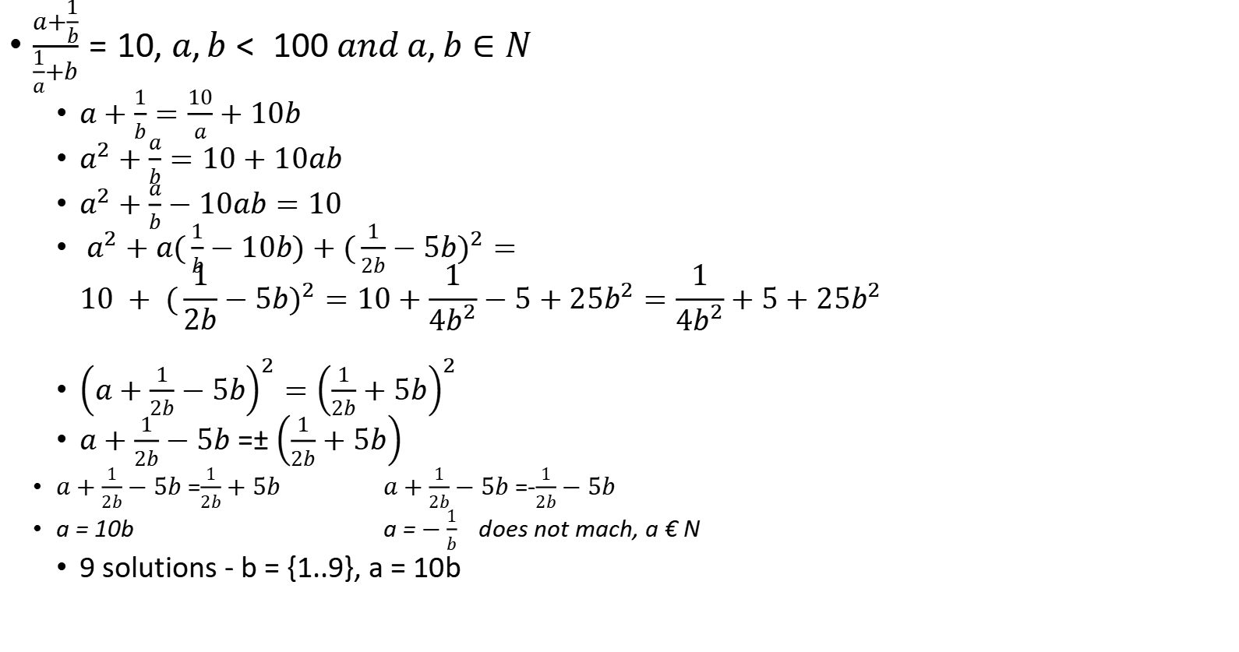
$\frac{a+\frac{1}{b}}{\frac{1}{a}+b}=10, a,b< 100 and a,b∈N$
$a+\frac{1}{b}=\frac{10}{a}+10b$
$a^{2}+\frac{a}{b}=10+10ab$
$a^{2}+\frac{a}{b}−10ab=10$
$a^{2}+a(\frac{1}{b}−10b)+{(\frac{1}{2b}−5b)}^{2}=$ $$10 + {(\frac{1}{2b}−5b)}^{2}=10+\frac{1}{4b^{2}}−5+25b^{2}=\frac{1}{4b^{2}}+5+25b^{2}$$
${\left(a+\frac{1}{2b}−5b\right)}^{2}={\left(\frac{1}{2b}+5b\right)}^{2}$
$a+\frac{1}{2b}−5b$ =$±\left(\frac{1}{2b}+5b\right)$
$a+\frac{1}{2b}−5b$ =$\frac{1}{2b}+5b$ $a+\frac{1}{2b}−5b$ =-$\frac{1}{2b}−5b$
a = 10b a = $−\frac{1}{b}$ does not mach, a € N
9 solutions - b = {1..9}, a = 10b

Slide 8
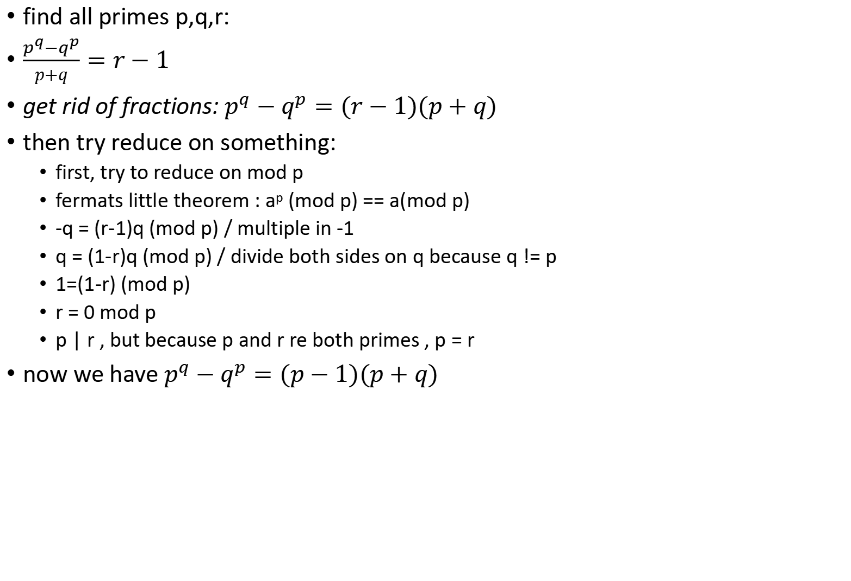
find all primes p,q,r:
$\frac{p^{q}−q^{p}}{p+q}=r−1$
get rid of fractions: $p^{q}−q^{p}=(r−1)(p+q)$
then try reduce on something:
first, try to reduce on mod p
fermats little theorem : a^{p} (mod p) == a(mod p)
-q = (r-1)q (mod p) / multiple in -1
q = (1-r)q (mod p) / divide both sides on q because q != p
1=(1-r) (mod p)
r = 0 mod p
p | r , but because p and r re both primes , p = r
now we have $p^{q}−q^{p}=(p−1)(p+q)$

Slide 9
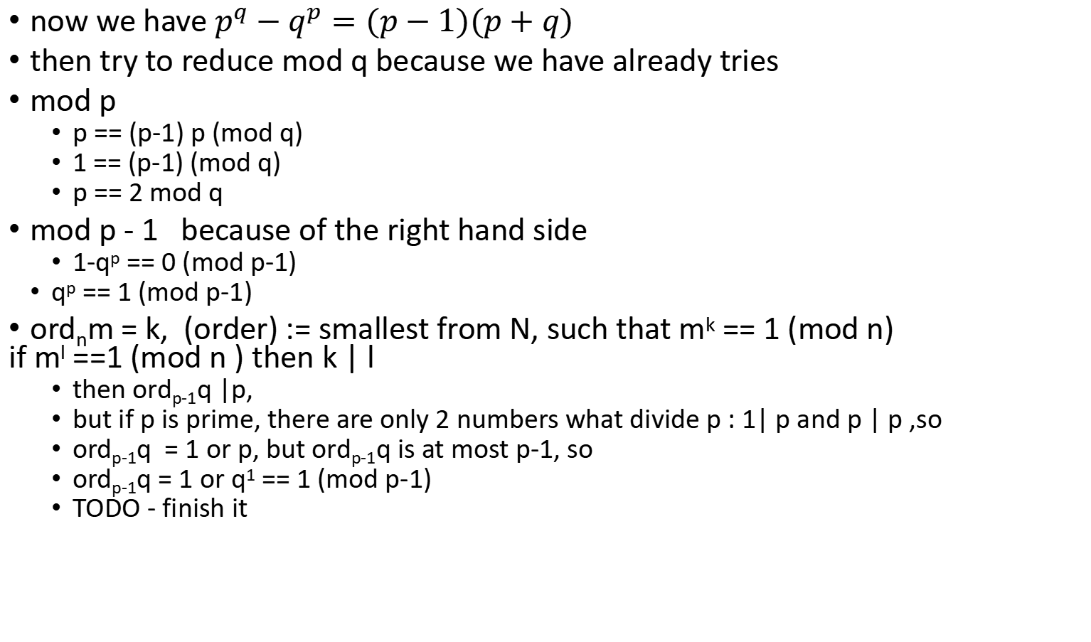
now we have $p^{q}−q^{p}=(p−1)(p+q)$
then try to reduce mod q because we have already tries
mod p
p == (p-1) p (mod q)
1 == (p-1) (mod q)
p == 2 mod q
mod p - 1 because of the right hand side
1-q^{p} == 0 (mod p-1)
q^{p} == 1 (mod p-1)
ord_{n}m = k, (order) := smallest from N, such that m^{k} == 1 (mod n) if m^{l} ==1 (mod n ) then k | l
then ord_{p-1}q |p,
but if p is prime, there are only 2 numbers what divide p : 1| p and p | p ,so
ord_{p-1}q = 1 or p, but ord_{p-1}q is at most p-1, so
ord_{p-1}q = 1 or q¹ == 1 (mod p-1)
TODO - finish it

Slide 10
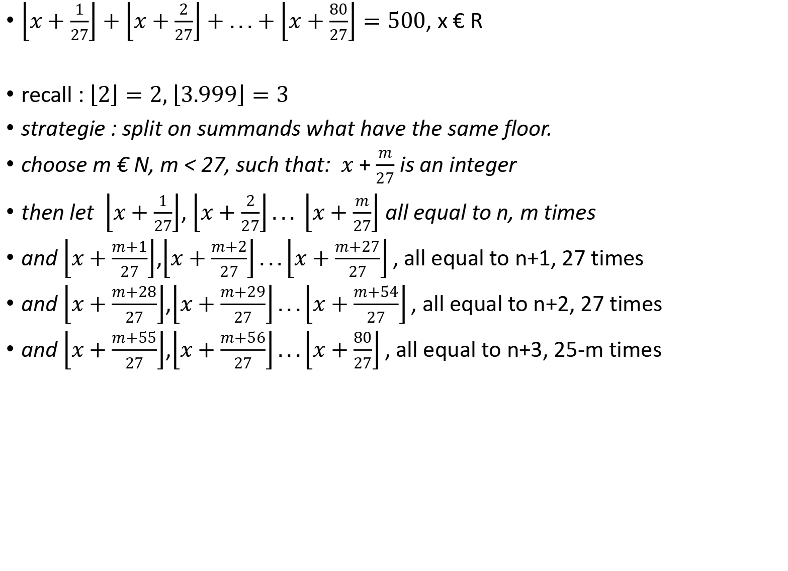
Floor functions
$\left\lfloor x+\frac{1}{27}\right\rfloor +\left\lfloor x+\frac{2}{27}\right\rfloor +...+\left\lfloor x+\frac{80}{27}\right\rfloor =500$, x € R
recall : $\left\lfloor 2\right\rfloor =2, \left\lfloor 3.999\right\rfloor =3$
strategie : split on summands what have the same floor.
choose m € N, m < 27, such that: $x+\frac{m}{27}$ is an integer
then let $\left\lfloor x+\frac{1}{27}\right\rfloor$, $\left\lfloor x+\frac{2}{27}\right\rfloor ... \left\lfloor x+\frac{m}{27}\right\rfloor$ all equal to n, m times
and $\left\lfloor x+\frac{m+1}{27}\right\rfloor$,$\left\lfloor x+\frac{m+2}{27}\right\rfloor ...\left\lfloor x+\frac{m+27}{27}\right\rfloor ,$all equal to n+1, 27 times
and $\left\lfloor x+\frac{m+28}{27}\right\rfloor$,$\left\lfloor x+\frac{m+29}{27}\right\rfloor ...\left\lfloor x+\frac{m+54}{27}\right\rfloor ,$all equal to n+2, 27 times
and $\left\lfloor x+\frac{m+55}{27}\right\rfloor$,$\left\lfloor x+\frac{m+56}{27}\right\rfloor ...\left\lfloor x+\frac{80}{27}\right\rfloor ,$all equal to n+3, 25-m times

Slide 11
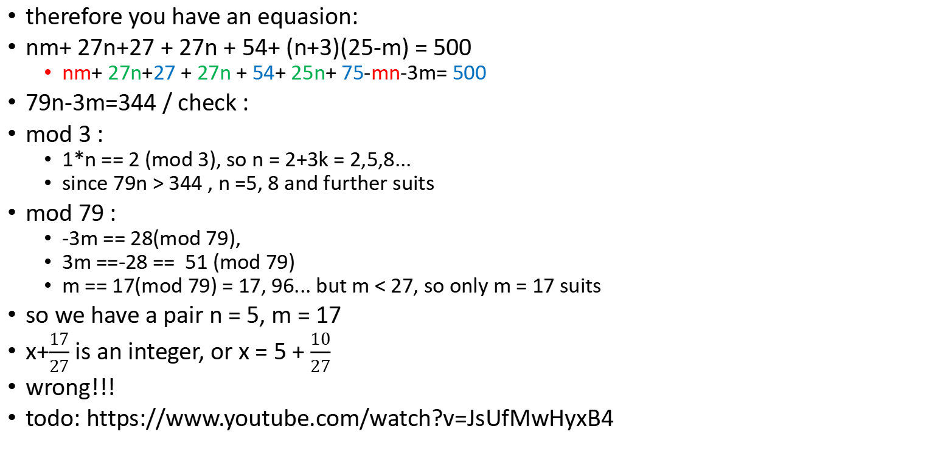
therefore you have an equasion:
nm+ 27n+27 + 27n + 54+ (n+3)(25-m) = 500
nm+ 27n+27 + 27n + 54+ 25n+ 75-mn-3m= 500
79n-3m=344 / check :
mod 3 :
1*n == 2 (mod 3), so n = 2+3k = 2,5,8...
since 79n > 344 , n =5, 8 and further suits
mod 79 :
-3m == 28(mod 79),
3m ==-28 == 51 (mod 79)
m == 17(mod 79) = 17, 96... but m < 27, so only m = 17 suits
so we have a pair n = 5, m = 17
x+$\frac{17}{27}$ is an integer, or x = 5 + $\frac{10}{27}$
wrong!!!
todo: https://www.youtube.com/watch?v=JsUfMwHyxB4

Slide 12
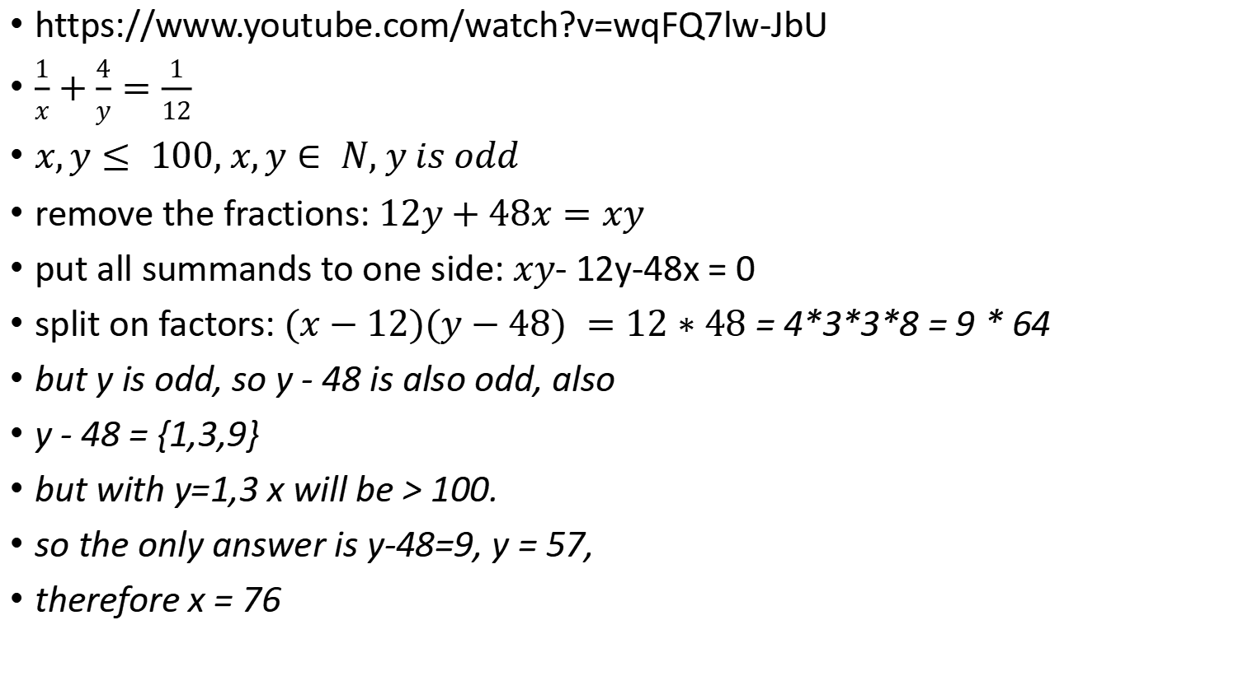
What would make this equation true??
https://www.youtube.com/watch?v=wqFQ7lw-JbU
$\frac{1}{x}+\frac{4}{y}=\frac{1}{12}$
$x,y≤ 100, x,y∈ N, y is odd$
remove the fractions:$12y+48x=xy$
put all summands to one side:$xy$- 12y-48x = 0
split on factors: $(x−12)(y−48) =12∗48$ = 4*3*3*8 = 9 * 64
but y is odd, so y - 48 is also odd, also
y - 48 = {1,3,9}
but with y=1,3 x will be > 100.
so the only answer is y-48=9, y = 57,
therefore x = 76

Slide 13
is this one fun?
https://www.youtube.com/watch?v=R0WC3USThlE
find all a,b € N, such that
a^{n+1}+2^{n+1}+1 is a multiple of a^{n}+2^{n}+1
lets see, what happens if n = 1 :
a²+4+1 (1) is a multiple of a+3
take an obvious multiple: a²-9 (2) is also multiple of a+3 , because = (a+3)(a-3)
lets take the difference between (1) and (2)
14 is a multiple of a+3
a+3 is a factor of 14
a+3 € {1,2,7,14}
a = 4 or 11
check: a = 4 : 21 is a multiple of 7 a = 11: 126 is a multiple of 14
solutions so far : (a=4, n = 1)( a = 11, n = 1)

Slide 14
n = 2:
a³+9 is a multiple of a²+5 (m2)
take an obvious multiple: a3+5a is also a multiple of a²+5
take the difference: 5a-9 is a multiple of a²+5
5a-9 >= a²+5
a²-5a+14 <=0
Discriminant: 25-4*14 < 0
so it must be always positie or negative
if we plug a =0, it is positive, so this expression must be always positive
so there is no 5a-9 is a multiple of a²+5 and therefore no (m2)

Slide 15
now take n >=3
check a = 1, a = 2 => this gives no solutions
so consider the case a >= 3
an obvious multiple : a^{n+1}+a2^{n}+a
take teh difference:
TODO - to finish

Slide 16
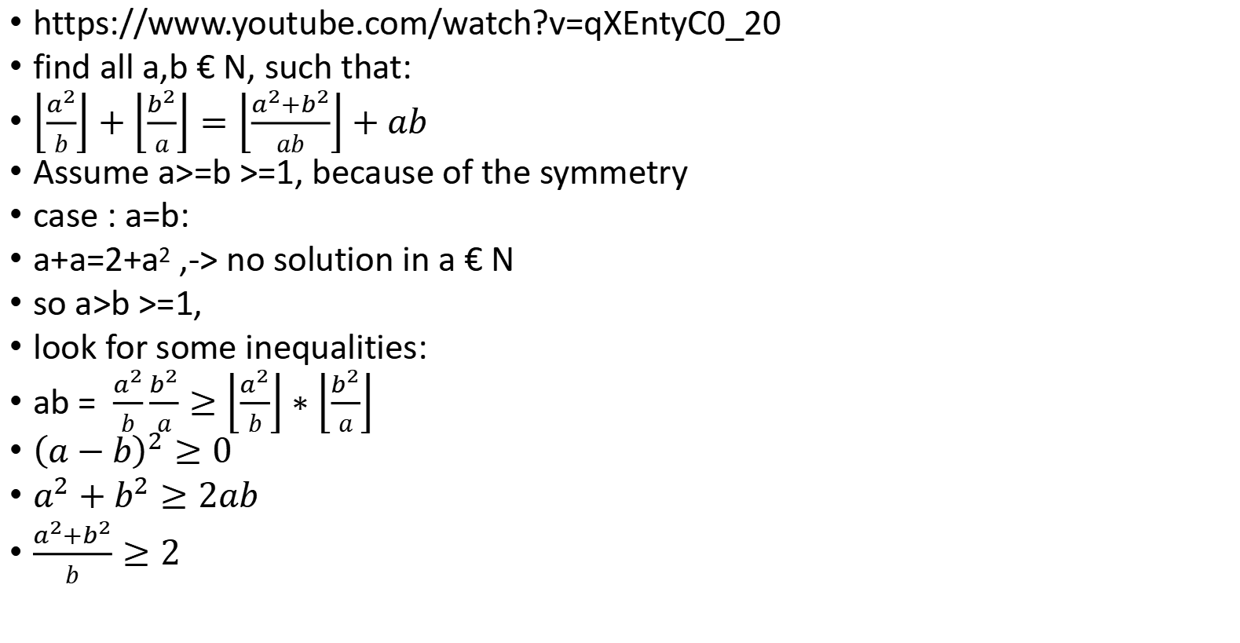
from the IMO shortlist...
https://www.youtube.com/watch?v=qXEntyC0_20
find all a,b € N, such that:
$\left\lfloor \frac{a^{2}}{b}\right\rfloor +\left\lfloor \frac{b^{2}}{a}\right\rfloor =\left\lfloor \frac{a^{2}+b^{2}}{ab}\right\rfloor +ab$
Assume a>=b >=1, because of the symmetry
case : a=b:
a+a=2+a² ,-> no solution in a € N
so a>b >=1,
look for some inequalities:
ab = $\frac{a^{2}}{b}\frac{b^{2}}{a}≥\left\lfloor \frac{a^{2}}{b}\right\rfloor ∗\left\lfloor \frac{b^{2}}{a}\right\rfloor$
${\left(a−b\right)}^{2}≥0$
$a^{2}+b^{2}≥2ab$
$\frac{a^{2}+b^{2}}{b}≥2$

Slide 17
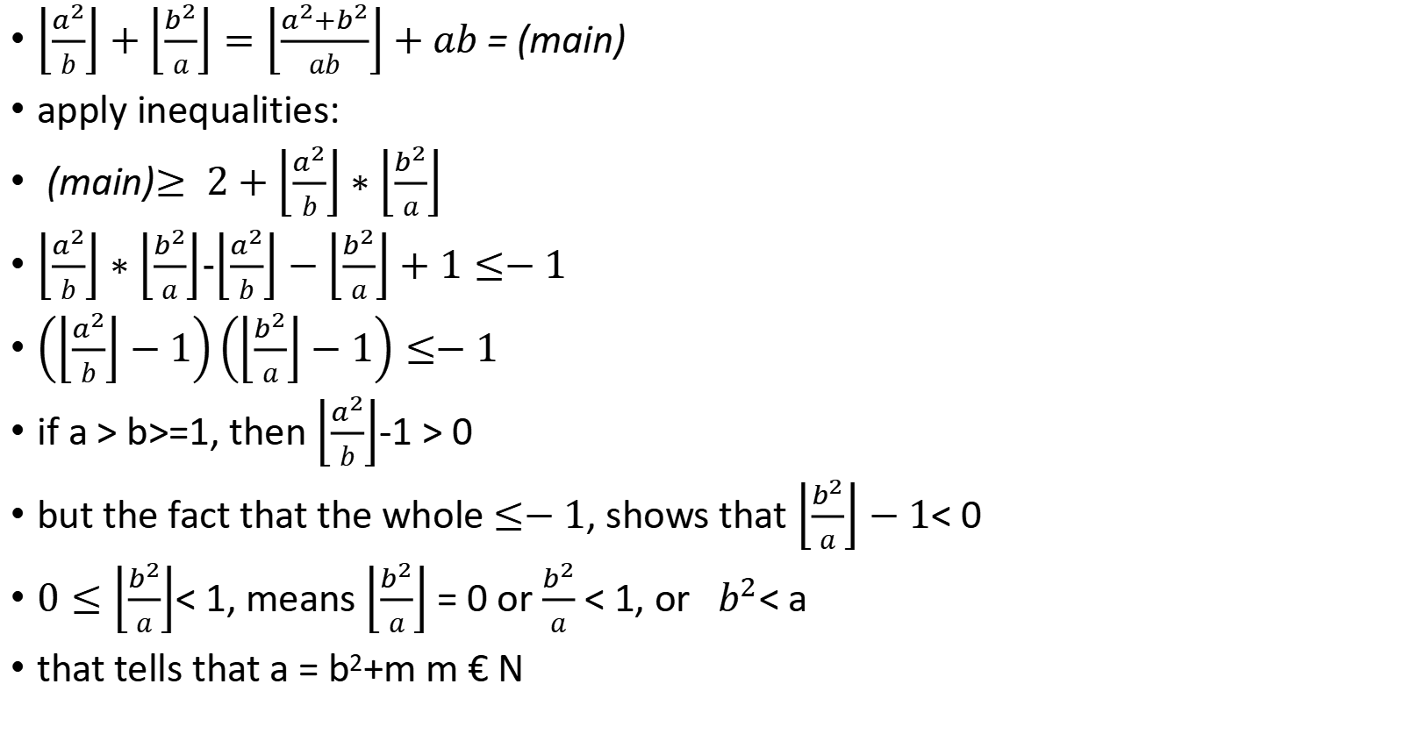
$\left\lfloor \frac{a^{2}}{b}\right\rfloor +\left\lfloor \frac{b^{2}}{a}\right\rfloor =\left\lfloor \frac{a^{2}+b^{2}}{ab}\right\rfloor +ab$ = (main)
apply inequalities:
(main)$≥ 2+\left\lfloor \frac{a^{2}}{b}\right\rfloor ∗\left\lfloor \frac{b^{2}}{a}\right\rfloor$
$\left\lfloor \frac{a^{2}}{b}\right\rfloor ∗\left\lfloor \frac{b^{2}}{a}\right\rfloor$-$\left\lfloor \frac{a^{2}}{b}\right\rfloor −\left\lfloor \frac{b^{2}}{a}\right\rfloor +1≤−1$
$\left(\left\lfloor \frac{a^{2}}{b}\right\rfloor −1\right)\left(\left\lfloor \frac{b^{2}}{a}\right\rfloor −1\right)≤−1$
if a > b>=1, then $\left\lfloor \frac{a^{2}}{b}\right\rfloor$-1 > 0
but the fact that the whole $≤−1$, shows that $\left\lfloor \frac{b^{2}}{a}\right\rfloor −1$< 0
$0≤\left\lfloor \frac{b^{2}}{a}\right\rfloor$< 1, means $\left\lfloor \frac{b^{2}}{a}\right\rfloor$ = 0 or $\frac{b^{2}}{a}$ < 1, or $b^{2}$< a
that tells that a = b²+m m € N

Slide 18
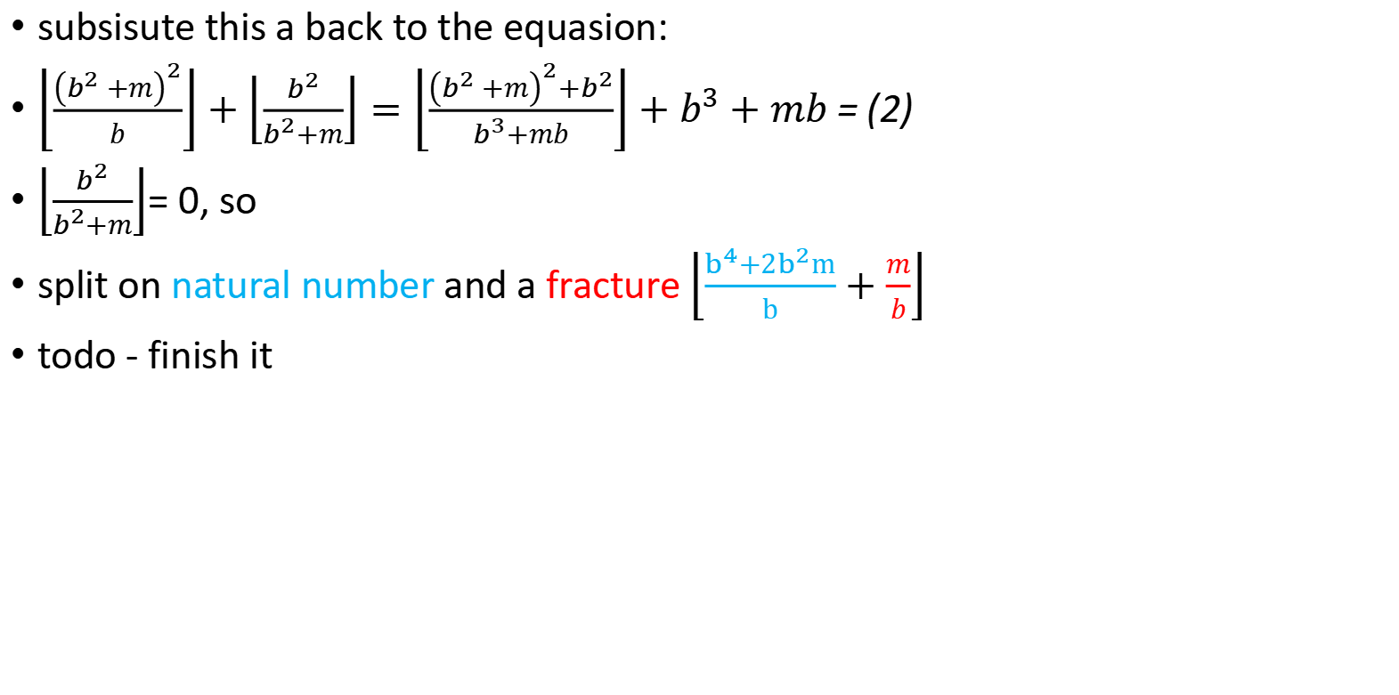
subsisute this a back to the equasion:
$\left\lfloor \frac{{\left(b^{2}+m\right)}^{2}}{b}\right\rfloor +\left\lfloor \frac{b^{2}}{b^{2}+m}\right\rfloor =\left\lfloor \frac{{\left(b^{2}+m\right)}^{2}+b^{2}}{b^{3}+mb}\right\rfloor +b^{3}+mb$ = (2)
$\left\lfloor \frac{b^{2}}{b^{2}+m}\right\rfloor$= 0, so
split on natural number and a fracture $\left\lfloor \frac{b^{4}+2b^{2}m}{b}+\frac{m}{b}\right\rfloor$
todo - finish it

Slide 19
which is NOT prime?
42²+42+41
43²+43+41
45²+45+41
44²+44+41 <- not a prime = 2021
44*44+44+41 = (43+1)*44+44+41 =43*44+44+44+41 =43*44+43+43+43
=43(44+1+1+1) =43*47

Slide 20
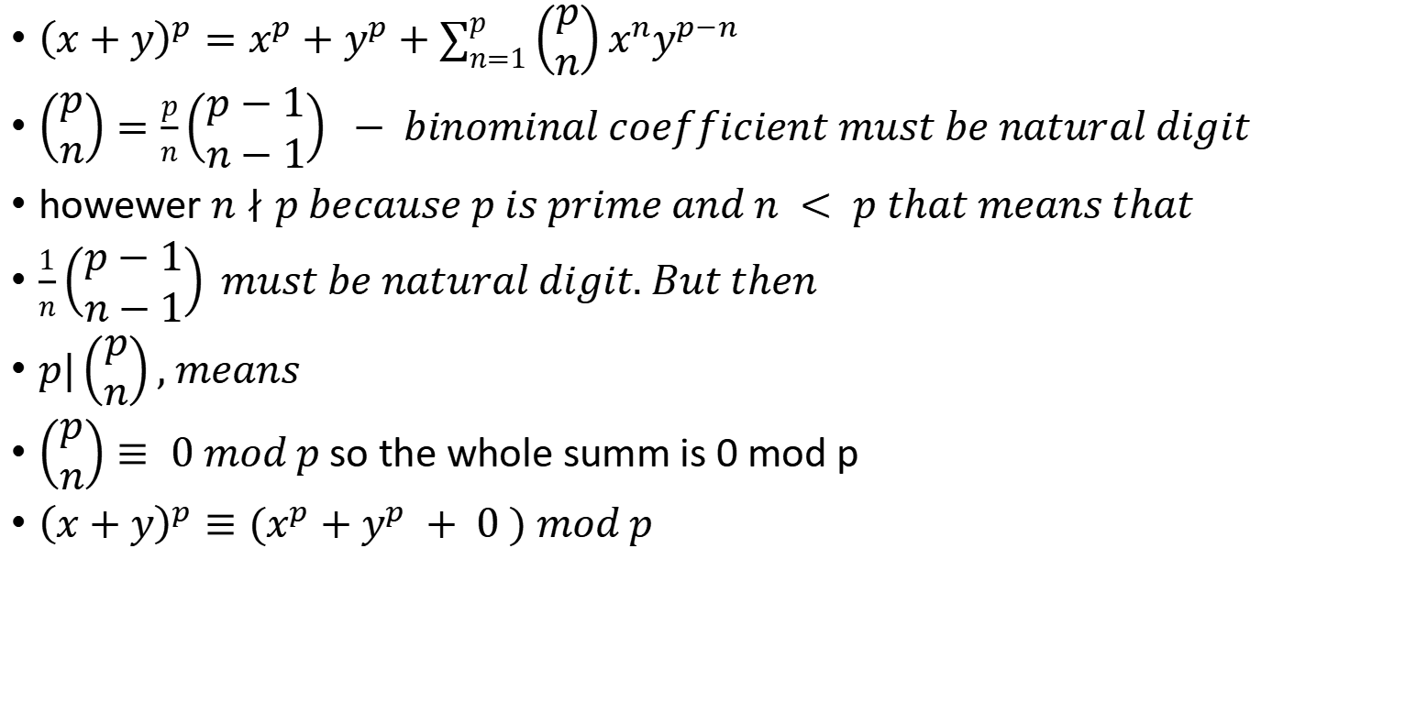
Freshman‘s dream : ${\left(x+y\right)}^{p}≡(x^{p}+y^{p})mod p$
${\left(x+y\right)}^{p}=x^{p}+y^{p}+\sum_{n=1}^{p}{\left(\begin{matrix}p \\ n\end{matrix}\right)}x^{n}y^{p−n}$
$\left(\begin{matrix}p \\ n\end{matrix}\right)=\frac{p}{n}\left(\begin{matrix}p−1 \\ n−1\end{matrix}\right) − binominal coefficient must be natural digit$
howewer $n∤p because p is prime and n < p that means that$
$\frac{1}{n}\left(\begin{matrix}p−1 \\ n−1\end{matrix}\right) must be natural digit. But then$
$p|\left(\begin{matrix}p \\ n\end{matrix}\right), means$
$\left(\begin{matrix}p \\ n\end{matrix}\right)≡ 0 mod p$so the whole summ is 0 mod p
${\left(x+y\right)}^{p}≡{(x}^{p}+y^{p} + 0 ) mod p$

Slide 21

Somore‘s Dream : $\int_{0}^{1}{x^{−x}dx =\sum_{n=1}^{∞}{n^{−n}}}$(main)
prove $\int_{0}^{1}{x^{n}}e^{x}dx=n!(1)$
$for n = 0 : \int_{0}^{∞}{e^{−x}dx={−e}^{−x}|_{0}^{∞}}=−−1=1$
for n = k +1:
$\int_{0}^{1}{x^{k+1}}e^{−x}dx=$
u = $x^{k+1}, du = (k+1)x^{k}$
v = ${−e}^{−x}, dv = e^{−x}dx$
(1)=$−x^{k−1}e^{−x}|_{0}^{∞}−−\int_{0}^{∞}{x^{k}e^{−x}dx=}\int_{0}^{∞}{x^{k}e^{−x}dx=}$(k+1)k!=(k+1)!
(main) = $\int_{0}^{1}{e^{−xlnx}dx }$
substitute $e^{x}=\sum_{n=0}^{∞}{\frac{x^{n}}{n!}}$
(main) = $\int_{0}^{1}{\sum_{n=0}^{∞}{\frac{{(−xlnx)}^{n}}{n!}}dx }$
change order:
(main)=$\sum_{n=0}^{∞}{\frac{1}{n!}\int_{0}^{1}{{\left(−xlnx\right)}^{n}dx}}$
substitute u = -ln x , x = $e^{−u}, x^{n}=e^{−nu},dx =− e^{−u}du$
main)= $\sum_{n=0}^{∞}{\frac{1}{n!}\int_{∞}^{0}{e^{−nu}}}u^{n}$(-$e^{−u})$du =$\sum_{n=0}^{∞}{\frac{1}{n!}\int_{∞}^{0}{−e^{−(n+1)u}}}u^{n}$du
substitute t = (n+1)u , n is const , u = $\frac{t}{n+1}$, dt = (n+1)du , du =
(main)= $\sum_{n=0}^{∞}{\frac{1}{n!}\int_{0}^{∞}{{\left(\frac{t}{n+1}\right)}^{n}}}e^{−t}\frac{1}{n+1}dt=\sum_{n=0}^{∞}{\frac{1}{n!{\left(n+1\right)}^{n+1}}\int_{0}^{∞}{t^{n}}}e^{−t}dt=\sum_{n=0}^{∞}{\frac{n!}{n!{\left(n+1\right)}^{n+1}}}=\sum_{n=1}^{∞}{n^{−n}}$

Slide 22
x²+y² = 2022
both x and y are odd, because 2022 is not divisible by 4
2022 =(2m+1)²+(2n+1)² = 4m(m+1)+4n(n+1)+2 =
505 = m(m+1)+n(n+1)
but it is not ossible, because both are even.
2022 =1011*2 = 337*6 = ?

Slide 23

$$x^{2}+y^{2}=19451945$$
$19451945=1945∗10001=({44}^{2}+3^{2})({100}^{2}+1^{2})$
$\left(a^{2}+b^{2}\right)(c^{2}+d^{2})={\left(ac\right)}^{2}+{\left(bc\right)}^{2}+{\left(ad\right)}^{2}+{\left(bd\right)}^{2}=$
$={\left(ac\right)}^{2}+{\left(bd\right)}^{2}+2abcd+{\left(ad\right)}^{2}+{\left(bc\right)}^{2}−2abcd=$
${\left(ac+bd\right)}^{2}+{\left(ad−bc\right)}^{2}={\left(ac−bd\right)}^{2}+{\left(ad+bc\right)}^{2}$
$({44}^{2}+3^{2})({100}^{2}+1^{2})={(44∗100+3∗1)}^{2}+{(44∗1−3∗100)}^{2}=$
${4403}^{2}+{256}^{2}$

Slide 24
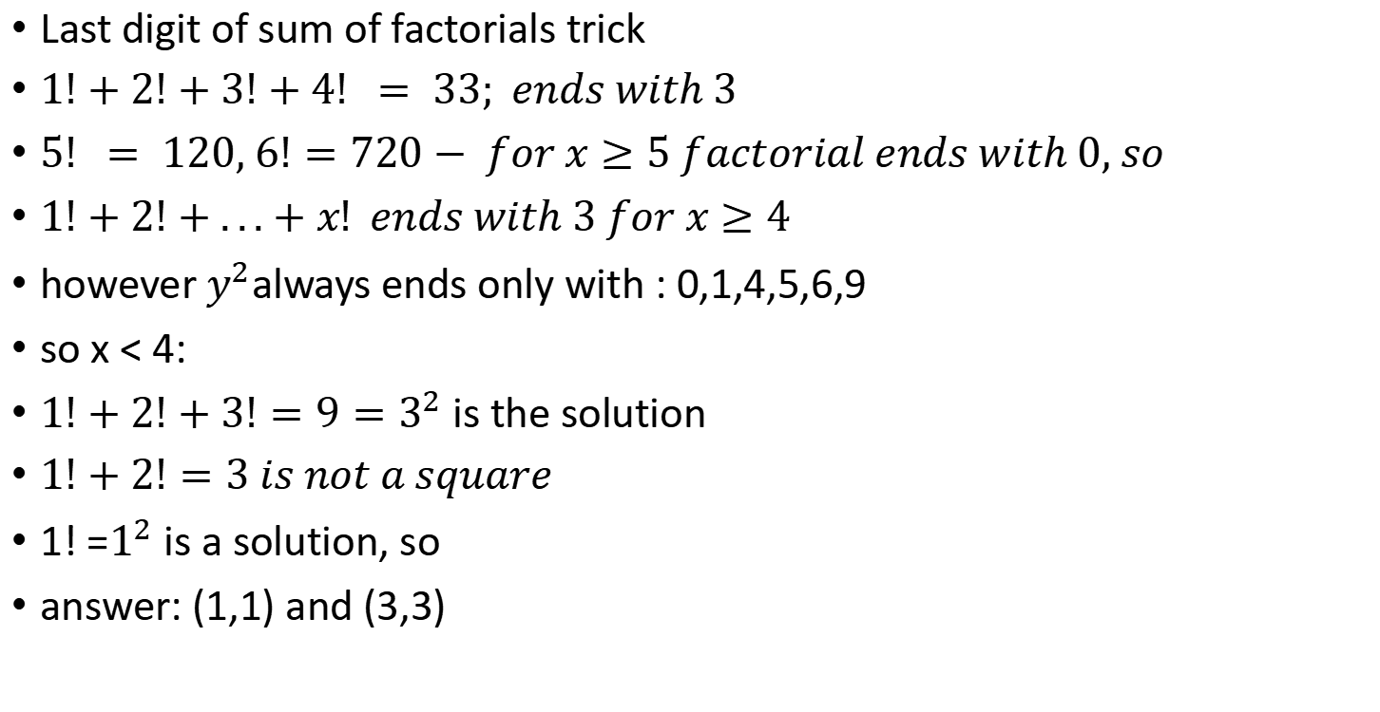
$1!+2!+...+x!=y^{2}$ for $x,y∈ Z$
Last digit of sum of factorials trick
$1!+2!+3!+4! = 33; ends with 3$
$5! = 120, 6!=720− for x≥5 factorial ends with 0, so$
$1!+2!+...+x! ends with 3 for x≥4$
however $y^{2}$always ends only with : 0,1,4,5,6,9
so x < 4:
$1!+2!+3!=9=3^{2}$ is the solution
$1!+2!=3 is not a square$
1! =$1^{2}$ is a solution, so
answer: (1,1) and (3,3)

Slide 25

Sum of digits of ${9999..99}^{2}of length n$
${\left({10}^{n}−1\right)}^{2}={10}^{2n}−2{∗10}^{n}+1$
what is ${10}^{2n}−2{∗10}^{n}?$
$\begin{matrix} 10..(0 x n−1times).. 0(last of bigger half) ..(0 x n times)− \\ −20..(0 x n times) \\ =(9 x n−1 times)...980..(n times)\end{matrix}$
so the sum would be 9(n-1)+8+1 = 9*n

Slide 26
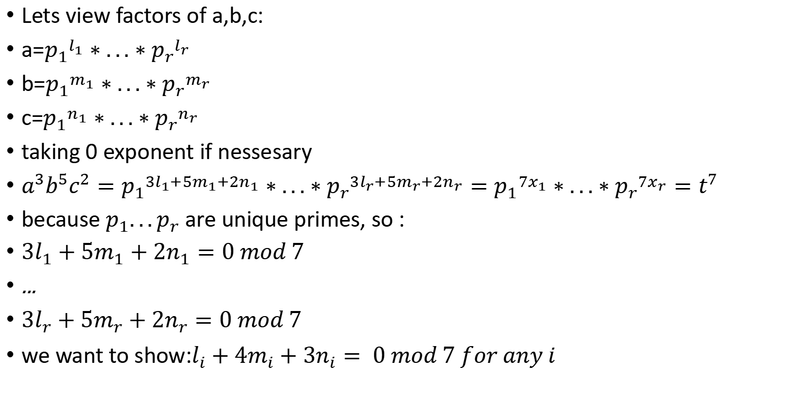
$$a^{3}b^{5}c^{2}is a perfect 7th powes, so is a^{1}b^{4}c^{3}$$
Lets view factors of a,b,c:
a=${p_{1}}^{l_{1}}∗...∗{p_{r}}^{l_{r}}$
b=${p_{1}}^{m_{1}}∗...∗{p_{r}}^{m_{r}}$
c=${p_{1}}^{n_{1}}∗...∗{p_{r}}^{n_{r}}$
taking 0 exponent if nessesary
$a^{3}b^{5}c^{2}={p_{1}}^{{3l}_{1}+5m_{1}+2n_{1}}∗...∗{p_{r}}^{{3l}_{r}+5m_{r}+2n_{r}}={p_{1}}^{7x_{1}}∗...∗{p_{r}}^{7x_{r}}=t^{7}$
because $p_{1}...p_{r}$ are unique primes, so :
${3l}_{1}+5m_{1}+2n_{1}=0 mod 7$
...
${3l}_{r}+5m_{r}+2n_{r}=0 mod 7$
we want to show:$l_{i}+4m_{i}+3n_{i}= 0 mod 7 for any i$

Slide 27

$$a^{3}b^{5}c^{2}is a perfect 7th powes, so is a^{1}b^{4}c^{3}$$
solution: multiply on sime number
$({3l}_{i}+5m_{i}+2n_{i})∗5={15l}_{i}+25m_{i}+10n_{i}=l_{i}+4m_{i}+3n_{i} mod 7$
also the same is true for ${6l}_{i}+3m_{i}+4n_{i} etc.$
short solution:
$t^{7∗5}={\left(a^{3}b^{5}c^{2}\right)}^{5}=a^{15}b^{25}c^{10}=a^{1}b^{4}c^{3} ∗a^{14}b^{21}c^{7}=a^{1}b^{4}c^{3}{\left(a^{2}b^{3}c^{1}\right)}^{7}$
is only possible if $a^{1}b^{4}c^{3}$ is a 7-th power ( how about 5-th power-?)

